Slide 1
Recognising special number sequences
Non-linear relationships

Slide 2
how to use Oak lessons

Slide 3
I can recognise a special number sequence.

Slide 4
An arithmetic (or linear) sequence is a sequence where the difference between successive terms is constant.
A geometric sequence is a sequence with a constant multiplicative relationship between successive terms.
A triangular number (or triangle number) is a number that can be represented by a pattern of dots arranged into an equilateral triangle. The term number is the number of dots in a side of the triangle.
1
3
6
10
15

Slide 5

Recognising special number sequences
Arithmetic and geometric sequences
Exploring other sequences

Slide 6
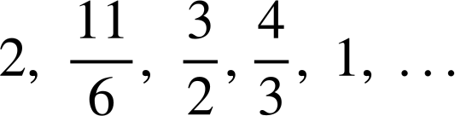
Arithmetic and geometric sequences
Arithmetic (linear) sequences have a common difference between successive terms.
How could we see which of these are the first five terms in an arithmetic sequence?
a) 81, 138, 195, 252, 309, …
b) −24, −13, −2, 13, 24, …
c) 21.7, 19.4, 17.1, 14.8, 12.5, …
d)
Work out the difference between successive terms and check it is the same between every pair of terms.

Slide 7





Arithmetic and geometric sequences
Which of these are the first five terms of an arithmetic sequence?
a) 81, 138, 195, 252, 309, …
b) −24, −13, −2, 13, 24, …
c) 21.7, 19.4, 17.1, 14.8, 12.5, …
d)
138 − 81 = 57
It must be arithmetic then
+ 57
+ 57
+ 57
+ 57
195 − 138 = 57
252 − 195 = 57
Aisha
309 − 252 = 57
Actually, we need to check the other terms.
Laura
So this is a linear sequence but it is still important that we checked every term.

Slide 8

Arithmetic and geometric sequences
Which of these are the first five terms of an arithmetic sequence?
a) 81, 138, 195, 252, 309, …
b) −24, −13, −2, 13, 24, …
c) 21.7, 19.4, 17.1, 14.8, 12.5, …
d)
−13 − (−24) = 11
+ 57
+ 57
+ 57
+ 57
−2 − (−13) = 11
Not arithmetic
13 − (−2) = 15
24 − 13 = 11
+ 11
+ 11
+ 15
+ 11
It’s a good job I kept checking all the terms this time!
Aisha

Slide 9
Arithmetic and geometric sequences
Which of these are the first five terms of an arithmetic sequence?
a) 81, 138, 195, 252, 309, …
b) −24, −13, −2, 13, 24, …
c) 21.7, 19.4, 17.1, 14.8, 12.5, …
d)
+ 57
+ 57
+ 57
+ 57
Laura
I find it easier to keep subtracting 2.3 and see if I get the next term
+ 11
+ 11
+ 15
+ 11
19.4 − 21.7 = − 2.3
− 2.3
− 2.3
− 2.3
− 2.3
19.4 − 2.3 = 17.1
17.1 − 2.3 = 14.8
14.8 − 2.3 = 12.5

Slide 10
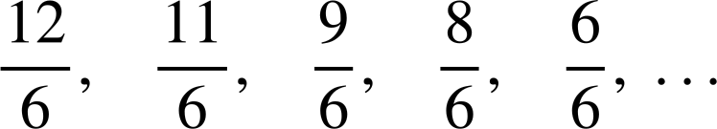


Arithmetic and geometric sequences
Which of these are the first five terms of an arithmetic sequence?
a) 81, 138, 195, 252, 309, …
b) −24, −13, −2, 13, 24, …
c) 21.7, 19.4, 17.1, 14.8, 12.5, …
d)
For the last one, using a common denominator may help.
+ 57
+ 57
+ 57
+ 57
+ 11
+ 11
+ 15
+ 11
− 2.3
− 2.3
− 2.3
− 2.3
The differences are not all the same so this is not an arithmetic sequence.

Slide 11

Arithmetic and geometric sequences
I have started a sequence 8, 12, 18, 27, …
Is Lucas’ sequence arithmetic?
No, The difference between the first two terms is 4 but this does not stay constant.
Lucas
What other type of sequence could it be?
Maybe it’s geometric?
How could we check if Aisha is correct?
Divide successive terms and see if there is a common ratio.
Aisha

Slide 12
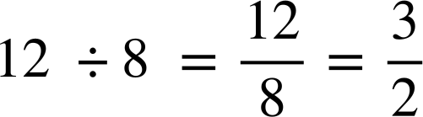

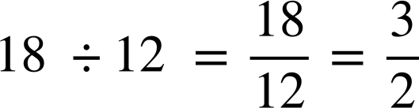
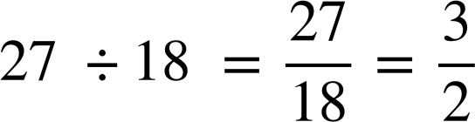

Arithmetic and geometric sequences
8, 12, 18, 27, …
So Aisha is correct, these could be the first four terms of a geometric sequence with common ratio of

Slide 13


Arithmetic and geometric sequences
Which of these could be the first four terms in a geometric sequence?
3, 12, 48, 194, …
48 × 4 = 192
× 4
× 4
2, 10, 50, 250, …
Common ratio of 5
× 5
× 5
× 5
16, 40, 100, 250, …
Common ratio of
−5, 10, 20, 40, …
Starts by multiplying by −2 then switches to multiplying by 2
× −2
× 2

Slide 14
Arithmetic and geometric sequences
Sequences can have algebraic expressions as terms.
The sequence which starts
a + 3, a + 7, a + 11, a + 15, …
Could be an arithmetic sequence with first term a + 3 and common difference (+ 4)
+ 4
+ 4
+ 4
What would be the next term if this was an arithmetic sequence?
a + b, a + 3b, a + 5b, …
a + 7b
+ 2b
+ 2b
+ 2b

Slide 15
Arithmetic and geometric sequences
I think a, 2a, 3a, 4a, … is a geometric sequence because it uses multiplication to get the next term.
Laura
Is Laura correct?
No a × 2 = 2a but 2a × 2 ≠ 3a
a, 2a, 3a, 4a, …
This could be a linear sequence with common difference (+a)
+ a
+ a
+ a

Slide 16
Arithmetic and geometric sequences
If a geometric sequence starts a, 2a, …
what would the next three terms be?
× 2
2a × 2 = 4a
4a × 2 = 8a
8a × 2 = 16a
a, 2a, 4a, 8a, 16a, ….
Is a geometric sequence with common ratio of 2

Slide 17
Arithmetic and geometric sequences
Which of these sequences could be geometric?
a , 5a, 10a, 50a, …
× 5
× 2
× 5
a , a², a³, a⁴, …
Common ratio of a
× a
× a
× a
a , ab, 2ab, 4ab, …
× b
× 2
× 2

Slide 18
Arithmetic and geometric sequences
Sort these sequences into the correct column of the table.
arithmetic | geometric | other
1, 2, 3, 4, 5, …
3, 9, 27, 81, ….
0.5, 1, 2, 4, …
1, 1, 2, 4, 7, …
1, 2, 4, 7, 11, …
−2, 4, −8, 16, …
−1, 5, 11, 17, 23, …
18, 35, 52, 69, 88, …
36, 12, −12, −36 …
13.5, 9, 6, 4, …
24, 12, 6 , 3 , 0, …

Slide 19
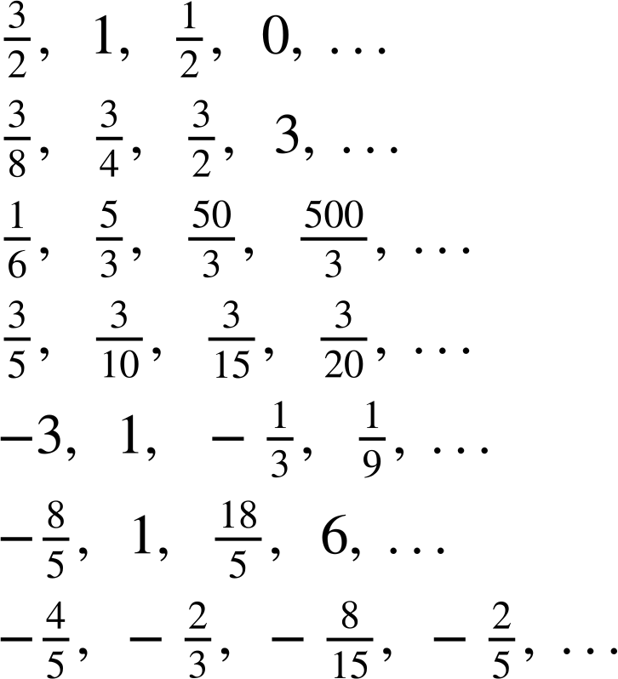
Arithmetic and geometric sequences
2) Sort these sequences into the correct column of the table.
arithmetic | geometric | other
a)
b)
c)
d)
e)
f)
g)

Slide 20
Arithmetic and geometric sequences
3) A sequence starts 2a, 6a, …
If the sequence was arithmetic, what would the next three terms be?
If the sequence was geometric, what would the next three terms be?
Continue this sequence in another way, describe the rule you have used.

Slide 21
Arithmetic and geometric sequences
Sort these sequences into the correct column of the table.
arithmetic | geometric | neither
a) 1, 2, 3, 4, 5,… g) −1, 5, 11, 17, 23,... i) 36, 12, −12, −36,... | b) 3, 9, 27, 81,… c) 0.5, 1, 2, 4,... f) −2, 4, −8, 16,.. j) 13.5, 9, 6, 4, … | d) 1, 1, 2, 4, 7,... e) 1, 2, 4, 7, 11,... h) 18, 35, 52, 68,... k) 12, 6 , 3 , 0, …
1, 2, 3, 4, 5, …
3, 9, 27, 81, ….
0.5, 1, 2, 4, …
1, 1, 2, 4, 7, …
1, 2, 4, 7, 11, …
−2, 4, −8, 16, …
−1, 5, 11, 17, 23, …
18, 35, 52, 68, …
36, 12, −12, −36 …
13.5, 9, 6, 4, …
12, 6 , 3 , 0, …

Slide 22
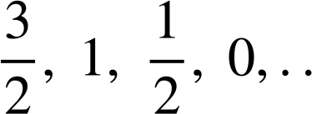
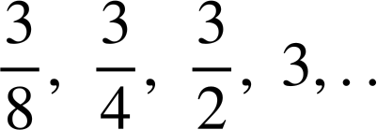
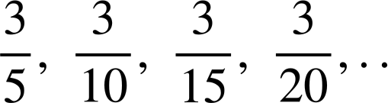
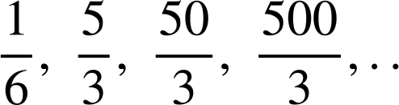
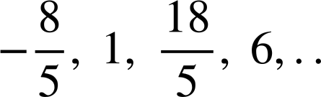
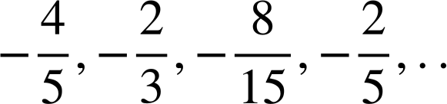
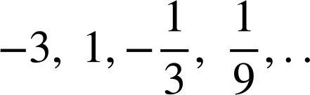
Arithmetic and geometric sequences
2) Sort these sequences into the correct column of the table.
arithmetic | geometric | neither
a) g) | b) c) e) | d) f)
a)
b)
c)
d)
e)
f)
g)

Slide 23
Arithmetic and geometric sequences
3) A sequence starts 2a, 6a, …
If the sequence was arithmetic, what would the next three terms be?
10a, 14a, 18a,….
If the sequence was geometric, what would the next three terms be?
18a, 54a, 162a, …
Continue this sequence in another way, describe the rule you have used.
Many possible answers.

Slide 24
Recognising special number sequences
Arithmetic and geometric sequences
Exploring other sequences

Slide 25
Exploring other sequences
There are other types of sequences that we can recognise from their key features as well.
3, 6, 11, 18, 27, …
× 2
+ 3
+ 5
+ 7
+ 9
This sequence is not geometric as there is no common ratio.
3 × 2 = 6 but 6 × 2 ≠ 11 and 11 × 2 ≠ 18
This sequence is not arithmetic as there is no common difference.
Can you describe a term-to-term rule that does work for these five terms?

Slide 26
Exploring other sequences
3, 6, 11, 18, 27, …
+ 3
+ 5
+ 7
+ 9
Can you describe a term-to-term rule that does work for these five terms?
You may have said:
The sequence adds 3, then 5, then 7, then 9, ….
The sequence is adding the odd numbers.
There is a linear pattern in the differences.
The differences are increasing by 2 each time.

Slide 27

Exploring other sequences
3, 6, 11, 18, 27, …
I’ve seen this before. The square numbers do something similar.
+ 3
+ 5
+ 7
+ 9
first difference
+2
+2
+2
second difference
Izzy
The sequence is not arithmetic as the differences between successive terms are not constant. However the differences between the differences are.
We can say there is a common second difference of 2
1, 4, 9, 16, 25, …
+ 3
+ 5
+ 7
+ 9
+2
+2
+2

Slide 28
Exploring other sequences
The sequence of all square numbers in ascending order has an n^{th} term rule of n² because squaring the term number gives the term.
1² = 1
2² = 4
3² = 9
4² = 16
5² = 25
Term number (n) | 1 | 2 | 3 | 4 | 5
Term (T) | 1 | 4 | 9 | 16 | 25
… | n
 | n²
+2
+2
+2
+2
+2
Term number (n) | 1 | 2 | 3 | 4 | 5
Term (T) | 3 | 6 | 11 | 18 | 27
… | n
 | n²+ 2
Our sequence has an n^{th} term rule of n² + 2 because each term is 2 more than the square numbers.

Slide 29
Exploring other sequences
What would happen if we subtracted 2 from the square numbers?
Term number | 1 | 2 | 3 | 4 | 5 | n
Term | 1 | 4 | 9 | 16 | 25 | n²
−2
−2
−2
−2
Lucas
Does this sequence still have a common second difference of 2?
Term number | 1 | 2 | 3 | 4 | 5 | n
Term | −1 | 2 | 7 | 14 | 23 | n²− 2
yes
+ 3
+ 5
+ 7
+ 9
+2
+2
+2

Slide 30
Exploring other sequences
What about if we doubled the square numbers?
Term number | 1 | 2 | 3 | 4 | 5 | n
Term | 1 | 4 | 9 | 16 | 25 | n²
× 2
× 2
× 2
× 2
Lucas
Term number | 1 | 2 | 3 | 4 | 5 | n
Term | 2 | 8 | 18 | 32 | 50 | 2n²
This sequence has a common second difference of 4
+ 6
+ 10
+ 14
+ 18
+4
+4
+4

Slide 31
Exploring other sequences
Write down the first five triangular numbers to see if Izzy is correct.
I think the triangular numbers had a common second difference too.
Izzy
1, 3, 6, 10, 15, …
Izzy is correct, the triangular numbers have a common second difference of 1
+ 2
+ 3
+ 4
+ 5
+1
+1
+1
Any sequence which has a common second difference is called a quadratic sequence (you won’t need to remember the name of this type of sequence yet).

Slide 32

Exploring other sequences
Which of these have a common second difference?
(they would be called quadratic sequences).
a
7, 8, 10, 13, 17, …
+ 1
+ 2
+ 3
+ 4
+1
+1
+1
b
5, 7, 11, 17, 25, …
+ 2
+ 4
+ 6
+ 8
+2
+2
+2
c
6, 8, 12, 20, 36, …
+ 2
+ 4
+ 8
+ 16
+2
+4
+8

Slide 33
Exploring other sequences
Laura and Aisha are looking at the sequence which starts
2, 3, 5, 8, 13, …
This cannot be an arithmetic or geometric sequence
Maybe it’s quadratic?
Laura
Aisha
What do you think?
2, 3, 5, 8, 13, …
Laura is correct, however this sequence is also not quadratic.
+ 1
+ 2
+ 3
+ 5
+1
+1
+2

Slide 34
Exploring other sequences
The next term in the sequence is 21
2, 3, 5, 8, 13, 21, …
Can you spot a rule which tells you how this sequence is generated?
You may have spotted:
2 + 3 = 5
3 + 5 = 8
5 + 8 = 13
8 + 13 = 21
What would the next term be?
13 + 21 = 34

Slide 35
Exploring other sequences
My sequence starts on 10 and each term is generated by adding the two previous terms
Why are we unable to write Laura’s sequence down?
We don’t know the second term.
Write down the first five terms of Laura’s sequence.
Laura
The second term is 4
10, 4, 14, 18, 32, …
Can you change the second term so that the third term is smaller than the first?
If the second term was negative
E.g. 10, −2, 8, 6, 14, ….. or 10, −12, −2, −14, −16, …

Slide 36
Exploring other sequences
For these sequences each term is generated by adding the two previous terms. Work out the next three terms in each sequence.
1, 1, 2, …
7, 1, 8, …
8, 5, …
5, −3, …

Slide 37
Exploring other sequences
For these sequences each term is generated by adding the two previous terms. Work out the next three terms in each sequence.
1, 1, 2, 3, 5, 8 …
7, 1, 8, 9, 17, 26, …
8, 5, 13, 18, 31, …
5, −3, 2, −1, 1 …

Slide 38
Exploring other sequences
1) By working out the pattern, find the next two terms in each sequence.
2, 8, 32, 128, …
2, 8, 14, 20, …
2, 8, 15, 23, …
2, 8, 16, 26, …
2, 8, 10, 18, …
2, 8, 17, 29, …
8, 2, 10, 12, …
8, 2, −4, −10, …
3, 5, 11, 21, …
4, 6, 12, 22, …
6, 10, 22, 42, …
−3, −5, −8, −13, …
−3, −5, −7, −9, …
2, −6, 18, −54, …
1, −7, −10, −8, …

Slide 39
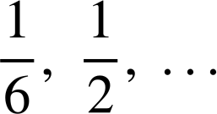
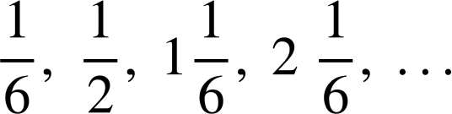
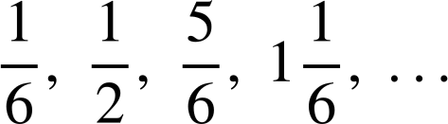
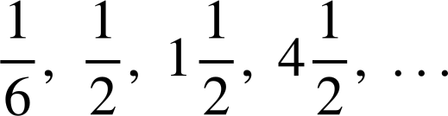
Exploring other sequences
2) Aisha, Izzy and Lucas have all created a sequence starting with the terms
For each question justify your answer.
Who has created an arithmetic sequence?
Who has created a geometric sequence?
Who has created a quadratic sequence?
(a sequence with a common second difference)
Aisha
Izzy
Lucas

Slide 40
Exploring other sequences
1) By working out the pattern, find the next two terms in each sequence.
2, 8, 32, 128, … 512, 2048 Geometric sequence with common ratio ×2
2, 8, 14, 20, … 26, 32, Arithmetic sequence with common difference +6
2, 8, 15, 23, … 32, 42 Quadratic sequence with second difference +1
2, 8, 16, 26, … 38, 52 Quadratic sequence with second difference +2
2, 8, 10, 18, … 28, 46 Add the two previous terms to get the next term
2, 8, 17, 29, … 44, 62 Quadratic sequence with second difference +3
8, 2, 10, 12, … 22, 34 Add the two previous terms to get the next term
8, 2, −4, −10, … −16, −22 Linear sequence with common difference −6

Slide 41
Exploring other sequences
1) By working out the pattern, find the next two terms in each sequence.
3, 5, 11, 21, … 35, 53 Quadratic sequence with second difference +4
4, 6, 12, 22, … 36, 54 Quadratic sequence with second difference +4
6, 10, 22, 42, … 70, 106 Quadratic sequence with second difference +8
−3, −5, −8, −13, … −21, −34 Add two previous terms to get the next term
−3, −5, −7, −9, … −11, −13 Arithmetic sequence with common difference −2
2, −6, 18, −54, … 162, −486 Geometric sequence with common ratio ×(−3)
1, −7, −10, −8, … −1 11 Quadratic sequence with second difference + 5
−8
−3
+2
+7
+12
+5
+5
+5
+5

Slide 42



Exploring other sequences
2) Aisha, Izzy and Lucas have all created a sequence starting with the terms
For each question justify your answer.
Who has created an arithmetic sequence?
Izzy, common difference
Who has created a geometric sequence?
Lucas, common ratio × 3
Who has created a quadratic sequence?
Aisha, the sequence then then
common second difference of
Aisha
Izzy
Lucas

Slide 43
Recognising special number sequences
Arithmetic sequences can be identified by checking for a common difference between terms.
Geometric sequences can be identified by checking for a common ratio between terms.
Some sequences have a common second difference, square and triangle numbers are examples of these.
(They are called quadratic sequences.)
Other rules can be used to create many different types of sequences.

Slide 44

© Oak National Academy 2024.
Produced in partnership with Mathematics in Education and Industry.
Licensed on the Open Government Licence v3.0, except where otherwise stated. See Oak terms and conditions.

